Slide 1

Training and Testing LeNet on Jetson Nano
August, 2023

Slide 2
Overview
1. Jetson Nano
Introduction of Jetson Nano
Setup and Initialization
2. Caffe
Install caffe
LeNet
Layers
Solver
MNIST
Training and testing

Slide 3
Overview
Jupyter notebook
Result
Accuracy
Loss
Confusion Matrix
Conclusion
3. Notes
4. Fashion MNIST
5. Appendix
6. References and sources

Slide 4
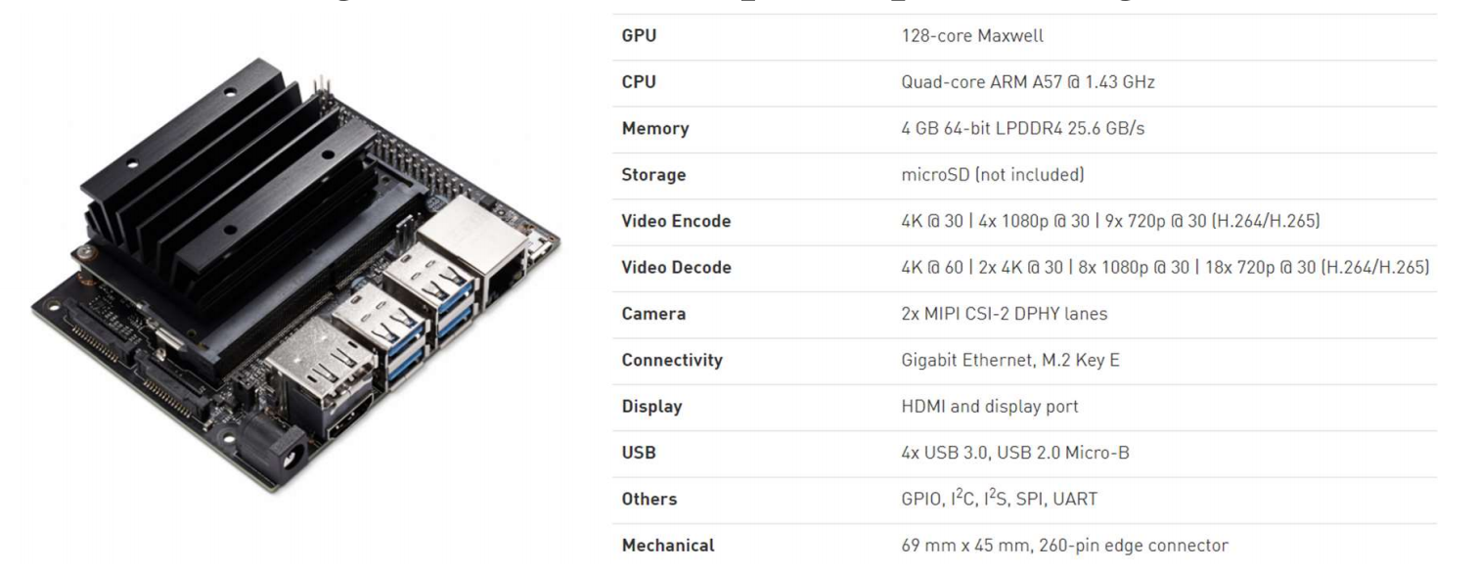
Introduction of jetsonnano
Introduction
The NVIDIA® Jetson Nano™ Developer Kit is a small AI computer for makers, learners, and developers.^{【1】}
1

Slide 5
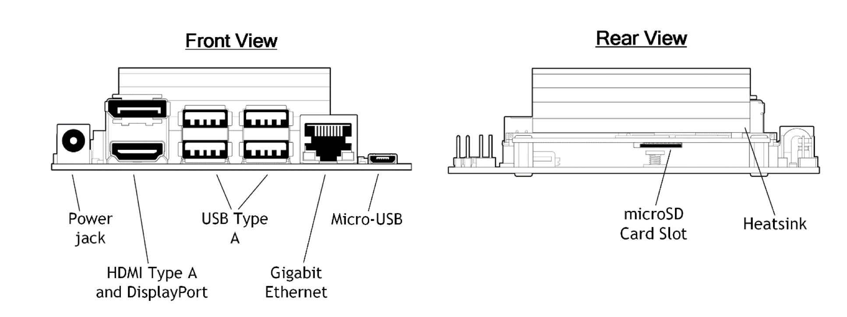
Introduction of jetsonnano
Developer kit interfaces
2

Slide 6
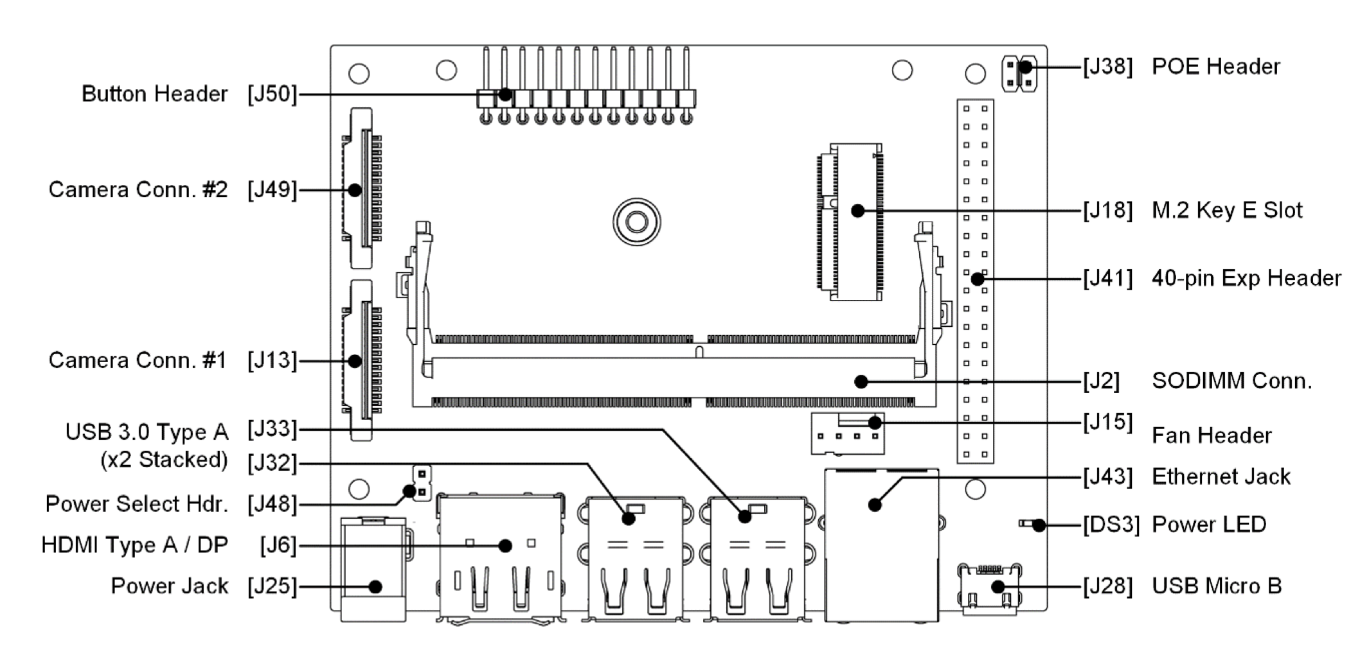
Introduction of jetsonnano
Developer kit interfaces
3

Slide 7
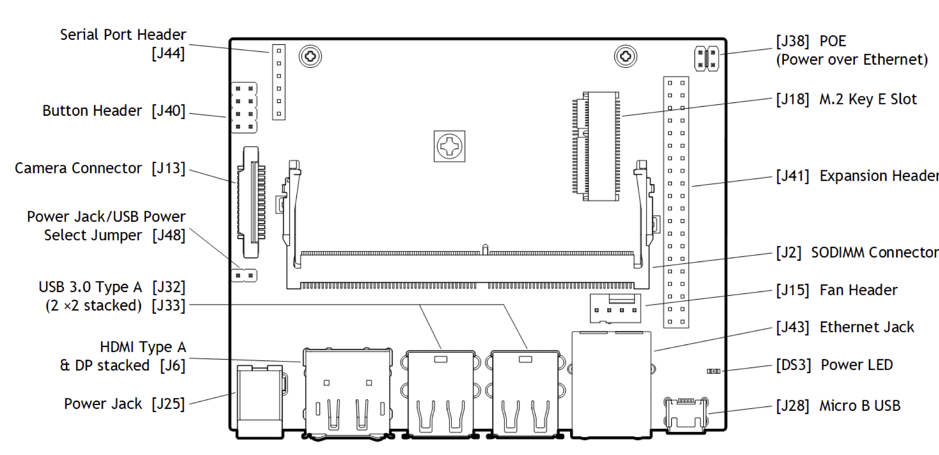
Introduction of jetsonnano
Developer kit interfaces
4

Slide 8
Setup and Initialization
Power supply and Setup^{【1】}
DC power supply: 5V⎓2A
MicroSD card: >=32GB: 64GB(this project)
Download the Jetson Nano Developer Kit SD Card Image and write the image to the microSD card.
Jumper the J48 Power Select Header pins
Connect the other computer to the developer kit’s Micro-USB port
Connect J43 Ethernet jack with internet
5

Slide 9
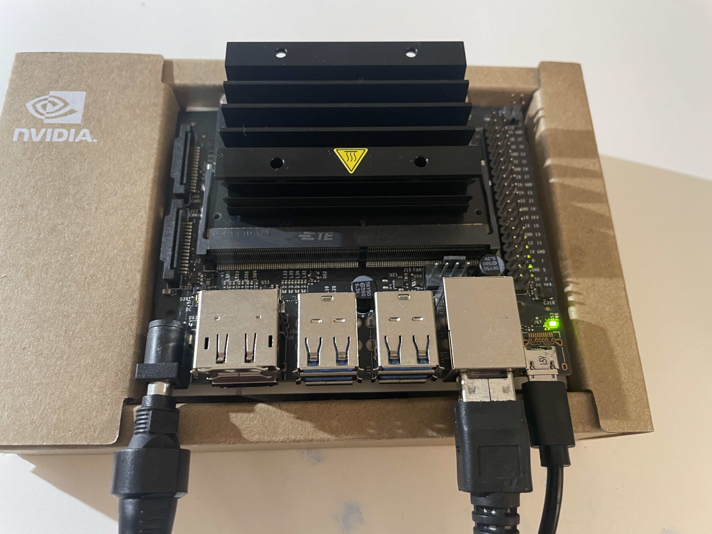
Setup and Initialization
Initial Setup Headless Mode^{【1】}
Insert the microSD card with system image
Connect the kit with PuTTY
First boot and register an account to log in
Now you can control the kit with PuTTY terminal
6

Slide 10
Caffe
Install Caffe^{【2】}
Caffe is a deep learning framework made with expression, speed, and modularity in mind.
Guidance^{[3]}：
Install caffe on a Jetson Nano with CUDA and cuDNN support.
Install dependencies
Download caffe
Build caffe
Run your caffe in python3
Add caffe to your PYTHONPATH
(Code see appendix)
7

Slide 11
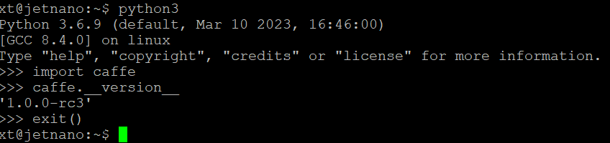
Caffe
Install Caffe^{【2】}
8

Slide 12
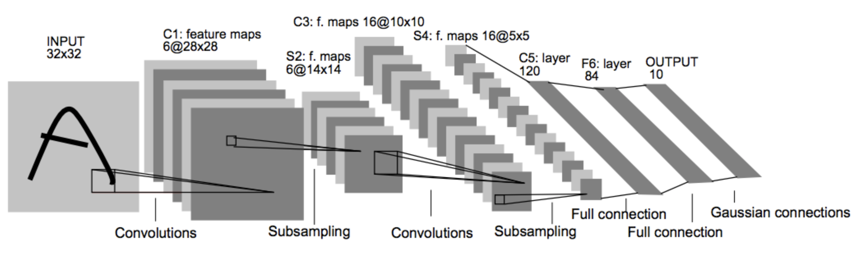
Caffe/LeNet
LeNet^{【4】}
LeNet is a convolutional neural network structure proposed by LeCun et al. in 1998,^{【4】}. In general, LeNet refers to LeNet-5 and is a simple convolutional neural network. It performs well in large-scale image processing.
9

Slide 13
Caffe/LeNet
LeNet^{【4】}
Regarding the training method employed by this algorithm, whenever an image is input to the network, it undergoes a process where it is divided into smaller segments referred to as local receptor fields. Given that every neuron or unit within a layer maintains connections to neurons in the preceding layer, these neurons can subsequently identify fundamental visual attributes, like edges and corners, from these local receptor fields. These extracted attributes are then integrated in the later layers of the network to construct more advanced features or mappings.
10

Slide 14
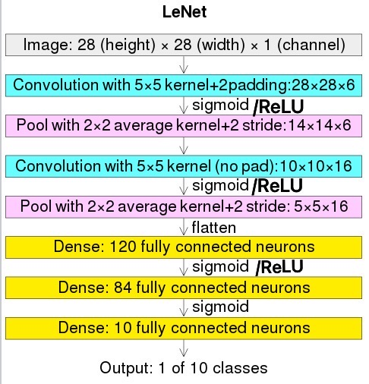
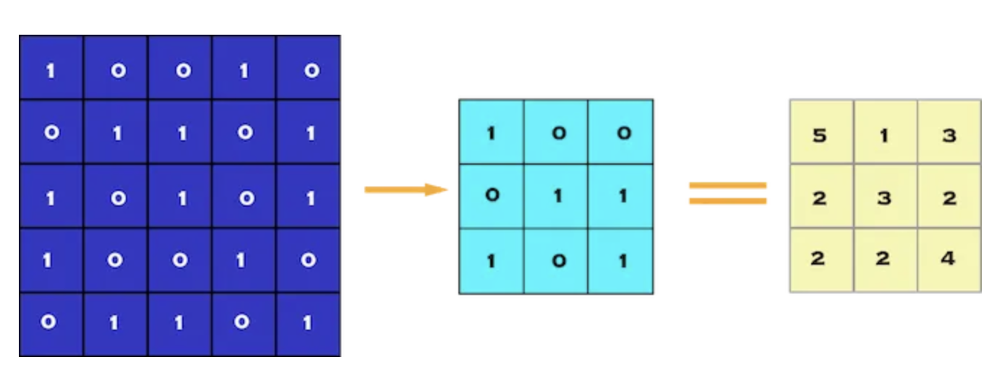
Caffe/LeNet
LeNet topology
Convolutional layers^{[5]}
The convolutional layer is the very first layer where we extract features from the images in our datasets. Due to the fact that pixels are only related to the adjacent and close pixels, convolution allows us to preserve the relationship between different parts of an image. Convolution is basically filtering the image with a smaller pixel filter to decrease the size of the image without losing the relationship between pixels.
11

Slide 15
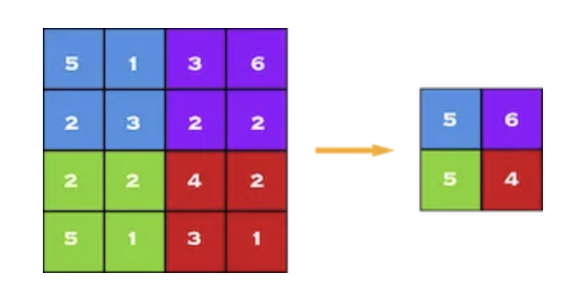
Caffe/LeNet
LeNet topology
Pooling layers^{[5]}
Insert pooling layers after each convolution layer to reduce the spatial size of the representation in order to reduce the computational complexity. And also solve the overfitting problems. Max pooling is selecting a pooling size and stride to choose max value inside these pixels.
12

Slide 16
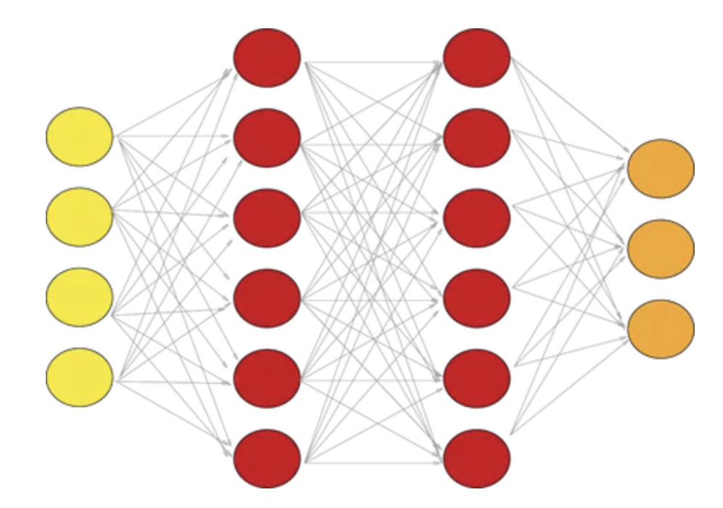
Caffe/LeNet
LeNet topology
Fully connected layers^{[5]}
A fully connected network is our RegularNet where each parameter is linked to one another to determine the true relation and effect of each parameter on the labels. Since our time-space complexity is vastly reduced thanks to convolution and pooling layers, we can construct a fully connected network in the end to classify our images.
13

Slide 17
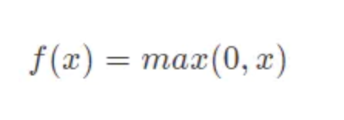
Caffe/LeNet
LeNet topology
Activation function ReLU^{[5]}
In this project, ReLU(Rectified linear unit) is used as activation function in fully connected layer. ReLU makes the output of some neurons become 0, creating sparsity in the network and reducing the interdependence of parameters, thereby alleviating the occurrence of overfitting issues.
14

Slide 18
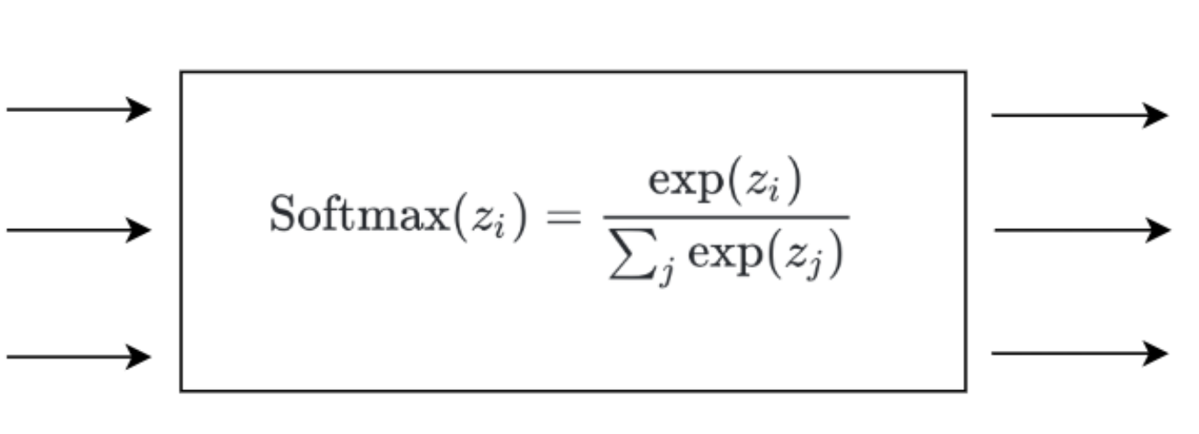
Caffe/LeNet
LeNet topology
Loss function Softmax^{[5]}
In this project, we use softmax layer as the output layer. The Sigmoid is a S-shaped response function that returns 0 or 1 in the output. Using Softmax as a loss function is particularly advantageous for multiclass classification tasks as it provides probabilistic interpretations, has well-defined gradients, ensures proper normalization, and is effective in minimizing classification errors.
15

Slide 19
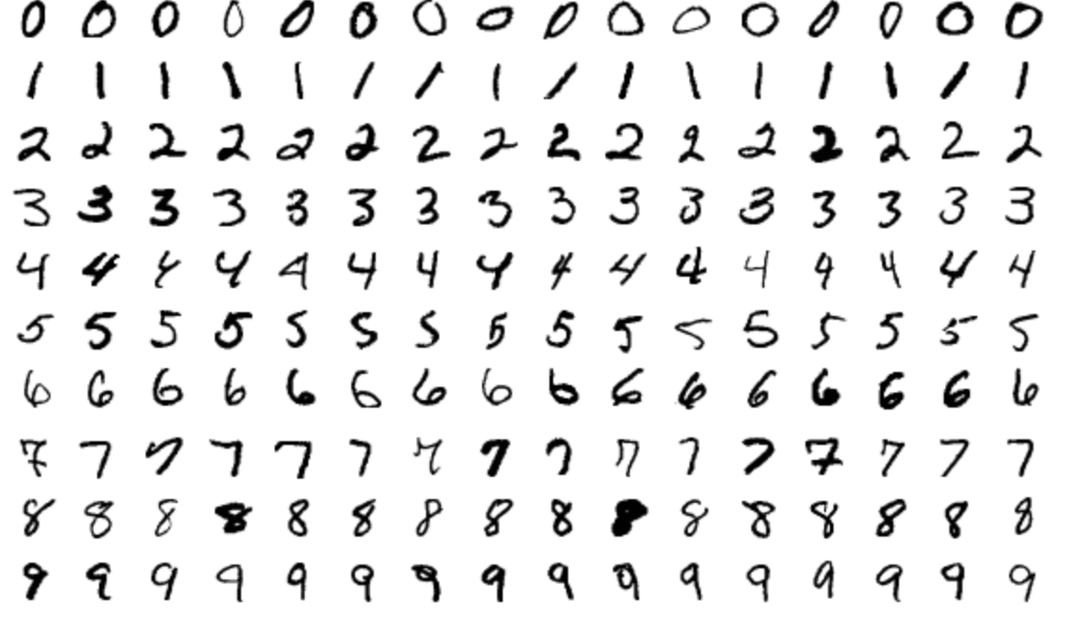
Caffe/MNIST
MNIST database^{【6】}
The MNIST database (Modified National Institute of Standards and Technology database) is a large database of handwritten digits that is commonly used for training various image processing systems. The black and white images from NIST were normalized to fit into a 28x28 pixel bounding box and anti-aliased, which introduced grayscale levels. The MNIST database contains 60,000 training images and 10,000 testing images. It normally can be used to test the performance of an CNN(Convolutional Neural Network). ^{[6]}
16

Slide 20
LeNet/Layers
Construct LeNet layers with Caffe^{【7】}
The network defines the entire model bottom-to-top from input data to loss. As data and derivatives flow through the network in the forward and backward passes Caffe stores, communicates, and manipulates the information as blobs: the blob is the standard array and unified memory interface for the framework. The layer comes next as the foundation of both model and computation.
A layer takes input through bottom connections and makes output through top connections. The models are defined in plaintext protocol buffer schema(prototxt).
Writing Layer Rules:
layer {
// ...layer definition...
include: { phase: TRAIN }
}
17

Slide 21
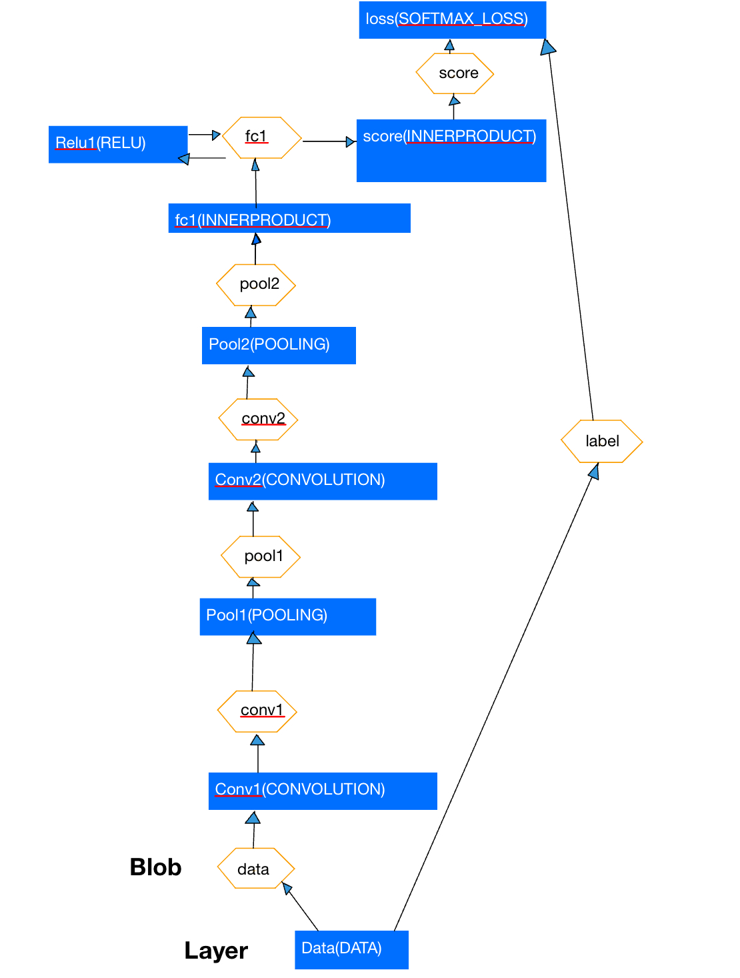
layer {
name: "data"
type: "Data"
top: "data"
top: "label"
transform_param {
scale: 0.003921568859368563
}
data_param {
source: "mnist/mnist_train_lmdb"
batch_size: 64
backend: LMDB
}
}
layer {
name: "conv1"
type: "Convolution"
bottom: "data"
top: "conv1"
convolution_param {
num_output: 20
kernel_size: 5
weight_filler {
type: "xavier"
}
}
}
LeNet/Layers
18

Slide 22
layer {
name: "pool1"
type: "Pooling"
bottom: "conv1"
top: "pool1"
pooling_param {
pool: MAX
kernel_size: 2
stride: 2
}
}
layer {
name: "conv2"
type: "Convolution"
bottom: "pool1"
top: "conv2"
convolution_param {
num_output: 50
kernel_size: 5
weight_filler {
type: "xavier"
}
}
}
LeNet/Layers
19

Slide 23
layer {
name: "pool2"
type: "Pooling"
bottom: "conv2"
top: "pool2"
pooling_param {
pool: MAX
kernel_size: 2
stride: 2
}
}
layer {
name: "fc1"
type: "InnerProduct"
bottom: "pool2"
top: "fc1"
inner_product_param {
num_output: 500
weight_filler {
type: "xavier"
}
}
}
layer {
name: "relu1"
type: "ReLU"
bottom: "fc1"
top: "fc1"
}
LeNet/Layers
20

Slide 24
llayer {
name: "score"
type: "InnerProduct"
bottom: "fc1"
top: "score"
inner_product_param {
num_output: 10
weight_filler {
type: "xavier"
}
}
}
layer {
name: "loss"
type: "SoftmaxWithLoss"
bottom: "score"
bottom: "label"
top: "loss"
}
LeNet/Layers
21

Slide 25
LeNet/Solver
Define the MNIST Solver^{【7】}
The "solver" is considered as the core of Caffe, and it coordinates the entire operation of the model. A necessary parameter for running a Caffe program is the solver configuration file. The typical command to run the code is usually :
# caffe train --solver=*_solver.prototxt
22

Slide 26
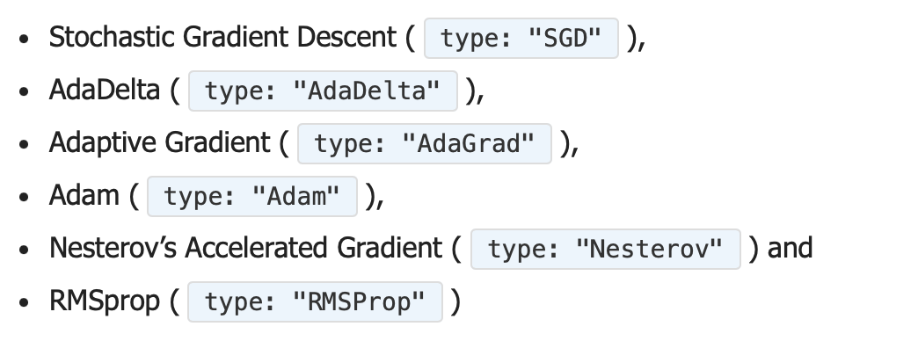
Caffe provides six optimization algorithms to find the optimal parameters, which can be selected in the solver configuration file by specifying the "type" parameter.
LeNet/Solver
Define the MNIST Solver^{【7】}
23

Slide 27
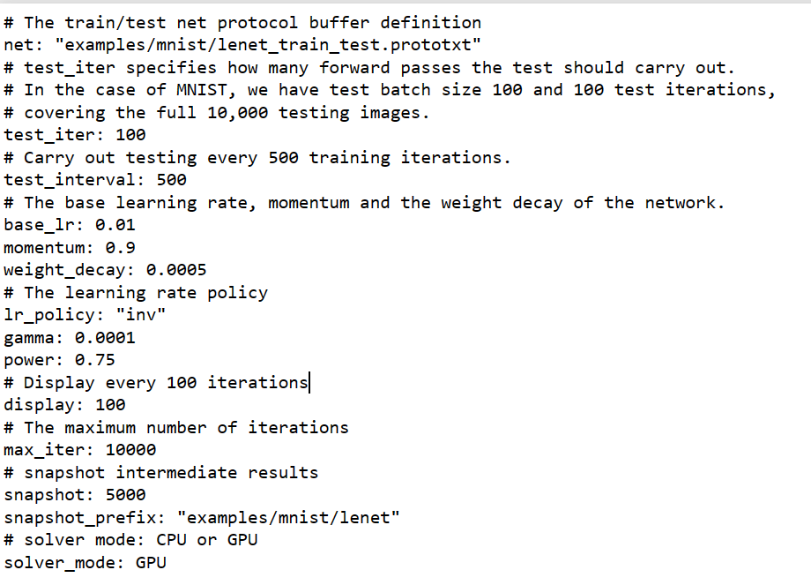
LeNet/Solver
In case overfitting
inv: return learning rate=base_lr * (1 + gamma * iter) ^ (- power)
5000 iterations save model and solver results in “examples/mnist/lenet
24

Slide 28
Training and testing
Training and Testing the Model^{【7】}
Training the model by simply run:
cd $CAFFE_ROOT
./examples/mnist/train_lenet.sh
25

Slide 29
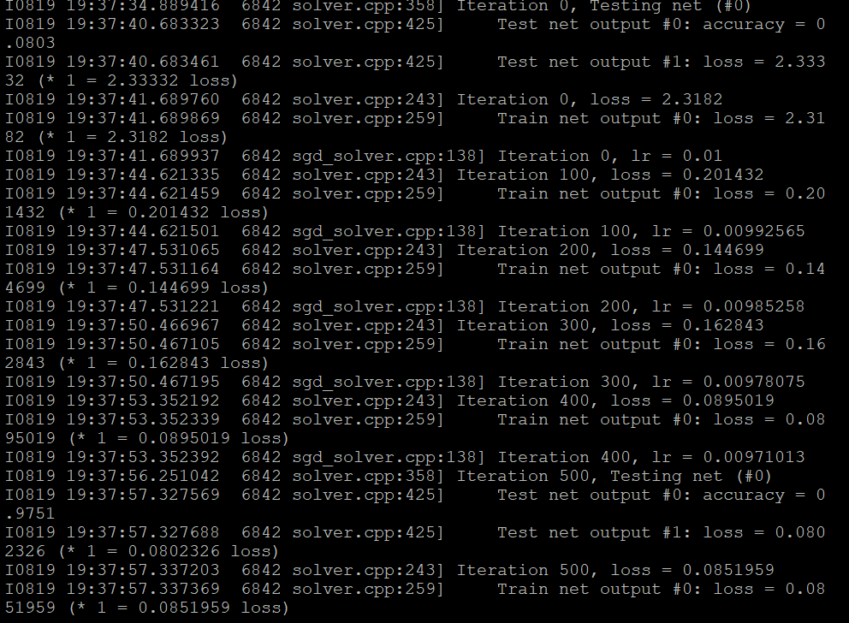
Training and testing
Based on the solver settings, we obtain the learning rate and training loss every 100 iterations, and test the network every 500 iterations to retrieve accuracy and testing loss functions.
26

Slide 30
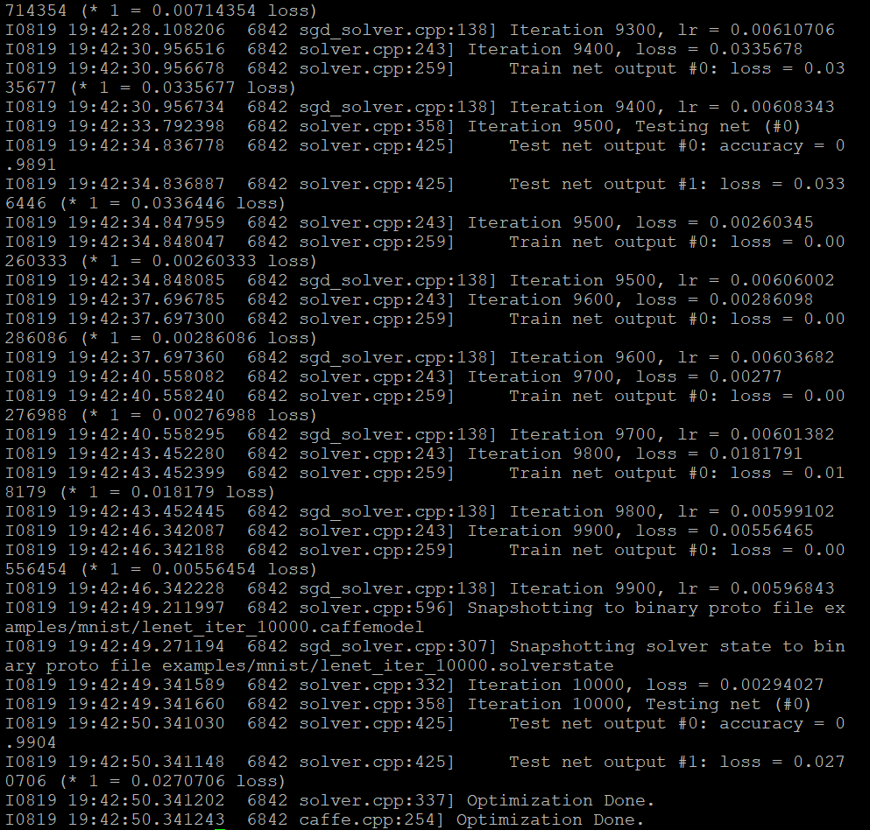
Training and testing
From the result we can see both training loss and testing loss is declining, which is good. The less the loss the better the robustness the model is.
The final accuracy is 0.9904 and the loss is 0.0270706.
27

Slide 31
Can we apply more benchmarks of the network?
28

Slide 32

Jupyter notebook
Jupyter notebook
（see details in appendix）
Since we initiate setup in headless mode, we could only connect the jetson nano with PuTTY window. We can use jupyter notebook to display images more intuitively and edit the code directly.
Jupyter notebook allows you to execute python code on a machine from the web server. Additionally, it allows the user to embed code and description in a single file, while capturing program output as you evaluate “cells” of code.
29

Slide 33
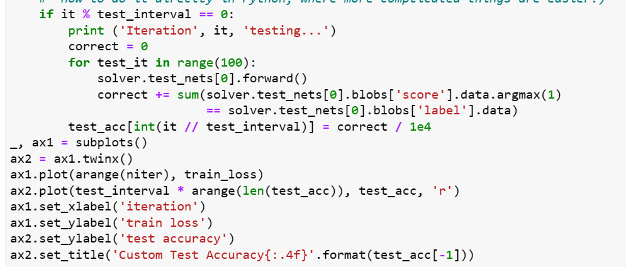
Jupyter notebook
Plot the train loss and test accuracy in python
30

Slide 34
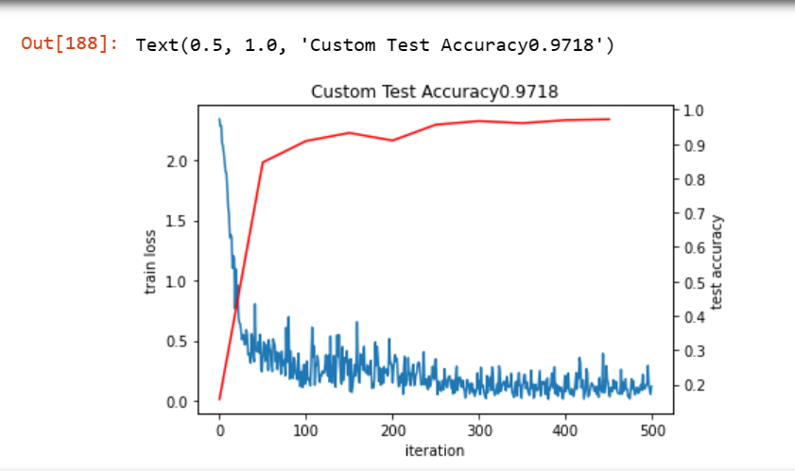
Result
Result [with different iteration]
500 iteration
31

Slide 35
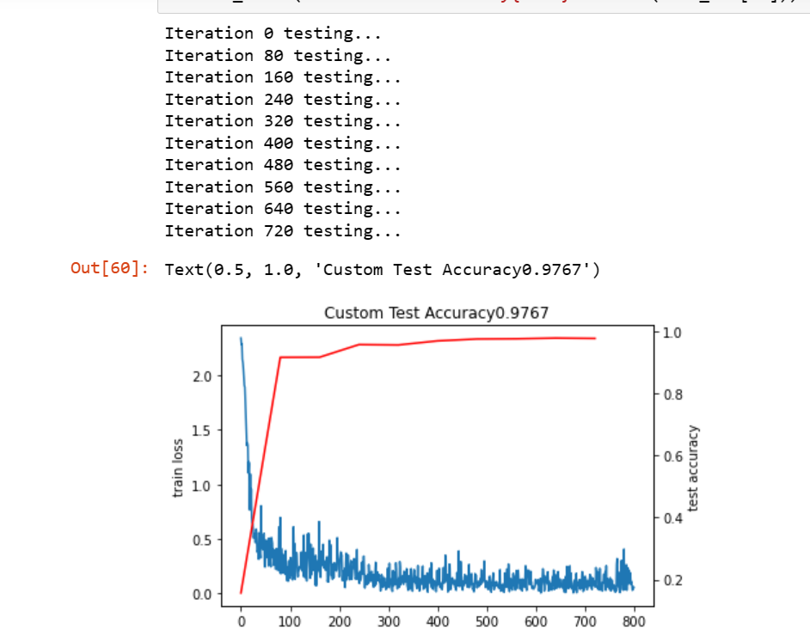
Result
Result [with different iteration]
800 iteration
32

Slide 36
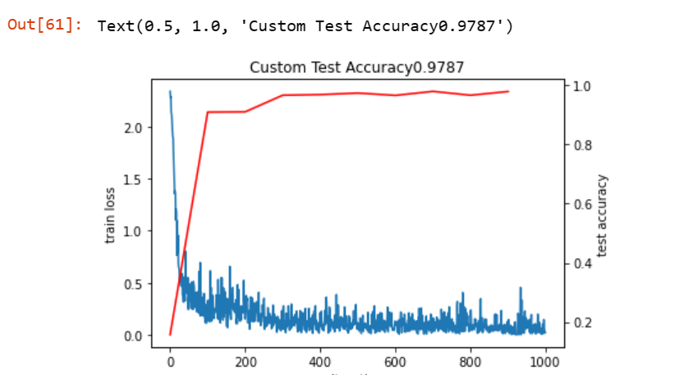
Result
Result [with different iteration]
We can see 1000 iteration has higher accuracy but the difference is not that obvious. And in case overfitting, we can set the iteration number as 500.
1000 iteration
33

Slide 37
Result
Result [with different solver types]
800 iteration with SGD
34

Slide 38
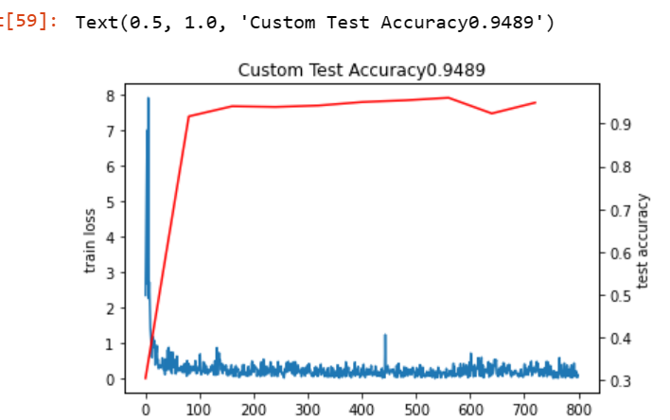
Result
Result [with different solver types]
We can see SGD has better performance.
800 iteration with Adam
35

Slide 39
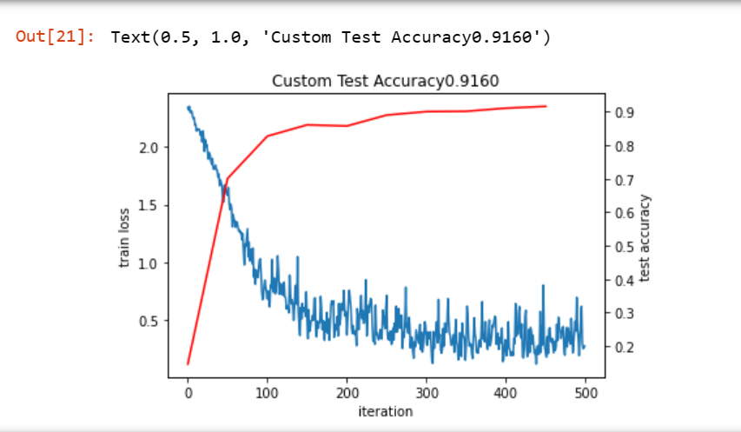
Result
Result [with different base learning rate]
base_lr=0.001
36

Slide 40
Result
Result [with different base learning rate]
Base learning rate 0f 0.01 has better accuracy. The proper learning rate ensures that the weights converge quickly without oscillations.
base_lr=0.01
37

Slide 41
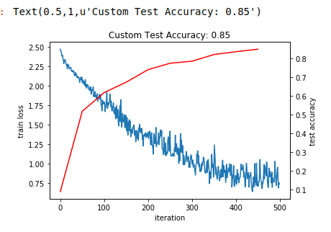
Result
Result [with different devices]
ubuntu virtual machine
Jetson nano
38

Slide 42
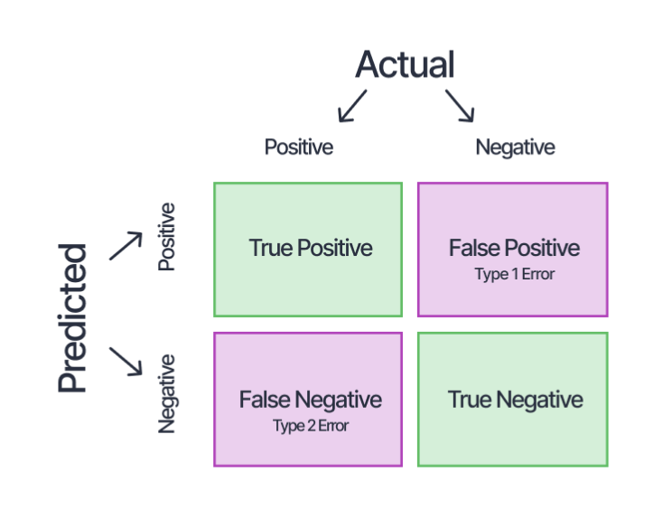
Result/Confusion matrix
Confusion matrix
A better method for evaluating classifier performance is by using a confusion matrix. The general idea is to count the number of instances from class A that were classified as class B. For example, to determine how many times the classifier confuses the digits 3 and 5, you can simply check the value at the intersection of the 5th row and the 3rd column in the confusion matrix.
39

Slide 43
Result/Confusion matrix
Confusion matrix
Confusion matrix can be implemented by adding a python layer in lenet prototxt file.
layer {
type: 'Python'
name: 'py_accuracy'
top: 'py_accuracy'
bottom: 'ip2'
bottom: 'label'
python_param {
# the module name -- usually the filename -- that needs to be in $PYTHONPATH
module: 'python_confmat'
# the layer name -- the class name in the module
layer: 'PythonConfMat'
param_str: '{"test_iter":100}'
}
include {
phase: TEST
}
}
40

Slide 44
Result/Confusion matrix
Confusion matrix
The file python_confmat.py must be copied in caffe/examples/mnist to work for the example. Ensure that in the Caffe configuration file, this section is set as follows: WITH_PYTHON_LAYER := 1. This step is essential to ensure that Caffe can recognize Python layers.
41

Slide 45
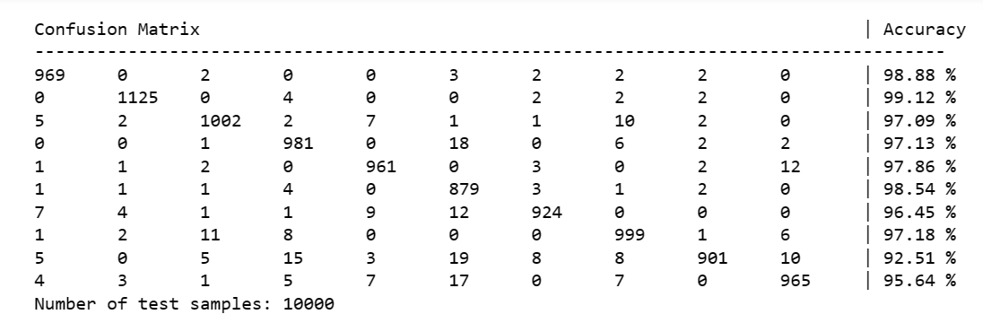
Result/Confusion matrix
Confusion matrix
Iteration 500 testing
42

Slide 46
Caffe/Conclusion
Conclusion
We have demenstrated how to use caffe framwork to implement a LeNet to train and test Mnist database and used its loss function, accuracy and confusion matrix as the benchmarks for this network. By changing the iteration times, opitimizer types, it gave us 500 iteration, SGD(Stochastic Gradient Descent ) optimizer(base learning rate as 0.01) has the best performance with less computation. In confusion matrix, class“8” is the hardest one to classify while class “1” achieved the highest accuracy.
43

Slide 47
^{Notes of Problems and troubles}
44

Slide 48
Notes
The first problem I encountered was importing Caffe into the Jetson Nano correctly. Due to the loss of some dependency packages, I couldn't build Caffe on the ARM device. After reinstalling those dependencies, I was able to import Caffe.
The second problem I faced was how to connect the Jupyter server of the Jetson Nano with my PC browser. Since I initiated the device in headless mode, there was only a PuTTY terminal that could control the Nano. PuTTY has its limitations in displaying graphs and images. To provide more useful and visually appealing results, I needed to use remote control to forward the Jupyter server of the Jetson Nano to my own PC port. In this case, I used SSH tunneling, as mentioned in the appendix.
45

Slide 49
Notes
The next problem was a code error while running the .ipynb file in Jupyter Notebook. Even after installing some missing modules, there were still some errors occurring after running one cell. The error hints pointed to syntax issues. Since the reference .ipynb file I used was from Lab3 of the Neurocomputing course, which used Python 2 as the Jupyter kernel, while I was using Python 3 as my Jupyter kernel, I suspected that the different code versions were causing these syntax errors. So, I meticulously reviewed every line of code but didn't find anything. This took up some time. Then I attempted another approach to fix this by installing the Python 2 kernel under the same virtual environment to change the Jupyter kernel to Python 2. However, more errors emerged, and I realized that I would need to install all requisite packages for the Python 2 version all over again. Still, there were many errors showing up. So, I reverted to using the Python 3 kernel. At this point, I believed that my virtual environment had become unstable due to the presence of different Python versions, so I don't recommend installing multiple Python versions in your virtual environment.
46

Slide 50
Notes
Finally, I found a possible syntax error: simply converting "(it // test_interval)" to an integral type. Voilà, I could run all cells smoothly without errors. However, the next day, a new error occurred when I ran the cell to import Caffe. It showed: "ImportError: /home/xt/miniforge3/envs/sar/bin/../lib/libgio-2.0.so.0: undefined symbol: g_unix_get_passwd_entry." To solve this error, I first checked Caffe on the Jetson Nano, and it imported smoothly. It just couldn't import under my virtual environment in Jupyter Notebook. According to the hint, I suspected that my libgio in Miniforge3 was probably different from that in my PuTTY terminal. So, I installed the newest version, but it showed that my version was already the newest in Miniforge3. It could be that the OpenCV installed in the Conda environment conflicted with the original Caffe dependency environment. So, I uninstalled OpenCV in Conda and deleted the libgio in Miniforge, attempting to link the PuTTY libgio to Miniforge. Surprisingly, after the deletion, the problem suddenly resolved.
The other issues I encountered were relatively easy to resolve.
47

Slide 51
Fahion MNIST
Fashion MNIST
Fashion-MNIST is a dataset of Zalando's article images—consisting of a training set of 60,000 examples and a test set of 10,000 examples. Each example is a 28x28 grayscale image, associated with a label from 10 classes.^{[8]}
48

Slide 52
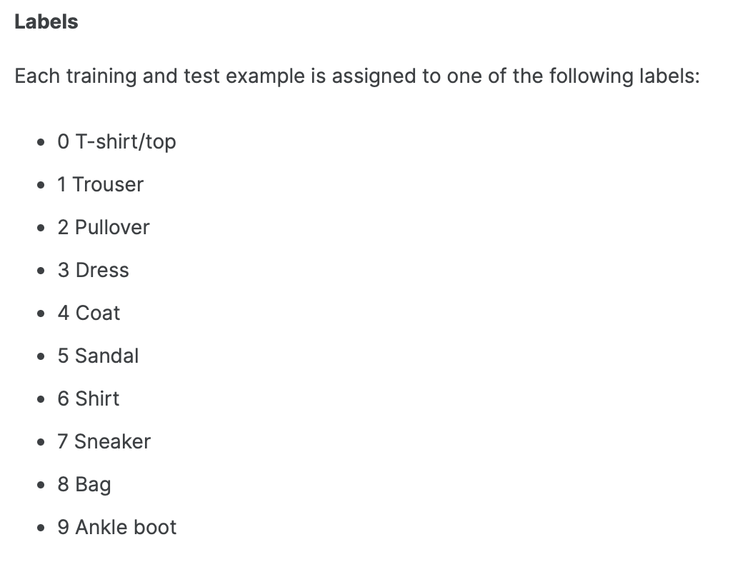
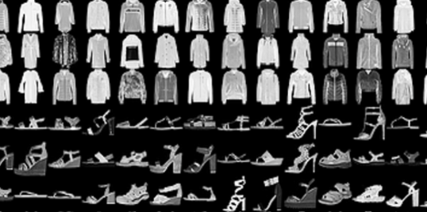
Fahion MNIST
Fashion MNIST
49

Slide 53
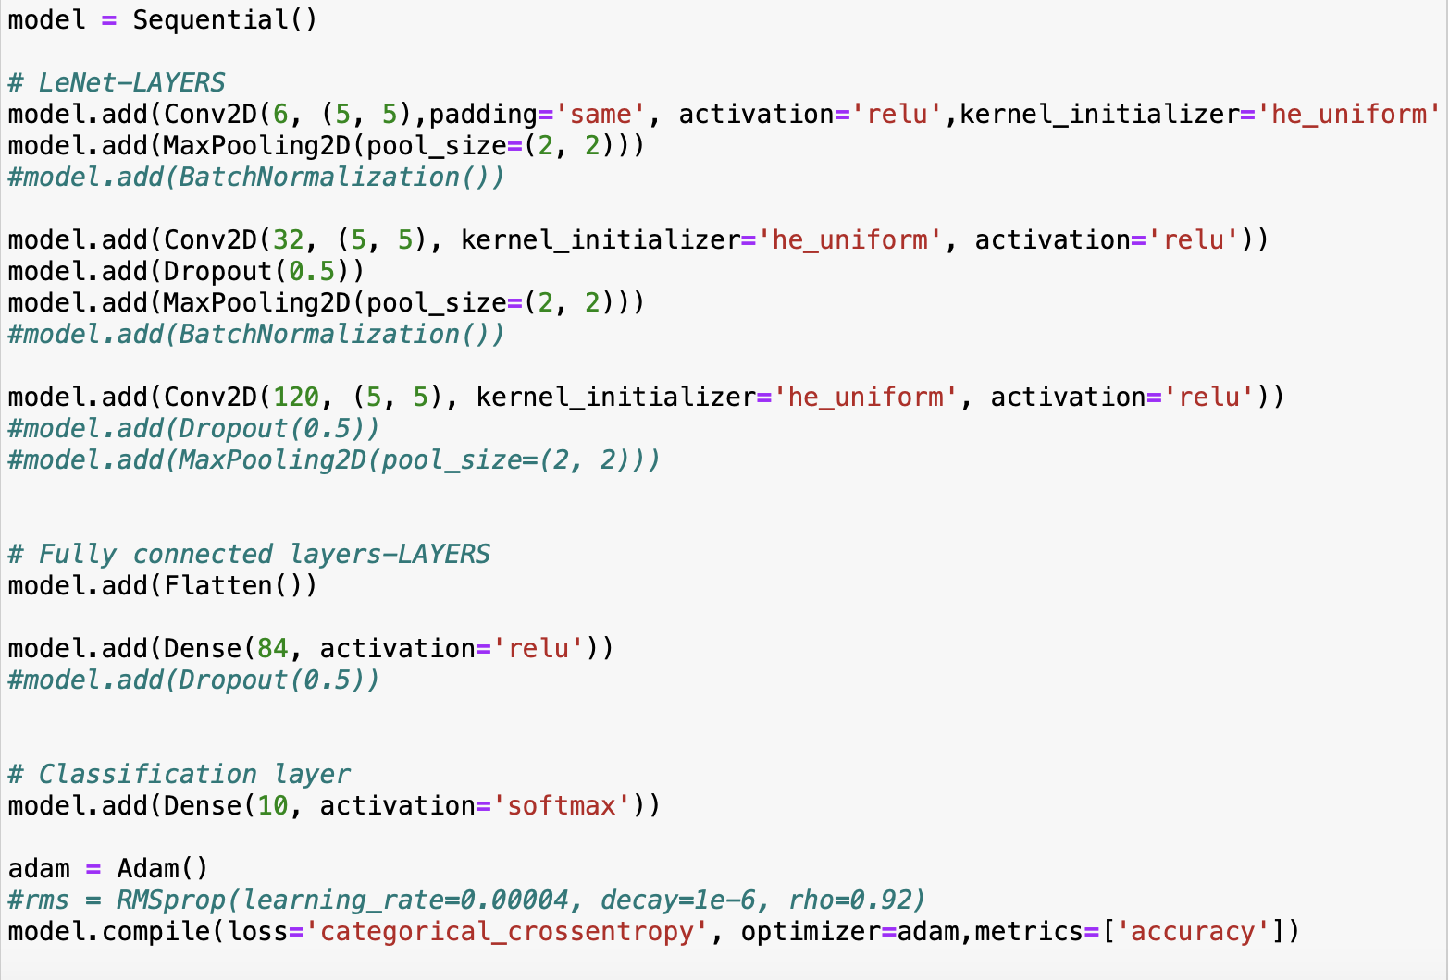
Fahion MNIST
Construct LeNet（With keras^{[9]}）
Fashion-MNIST is more complicated than traditional MNIST database. The lenet main layers remain the same as that in caffe, but the optimizer is changed to Adam in order to get better results.
50

Slide 54
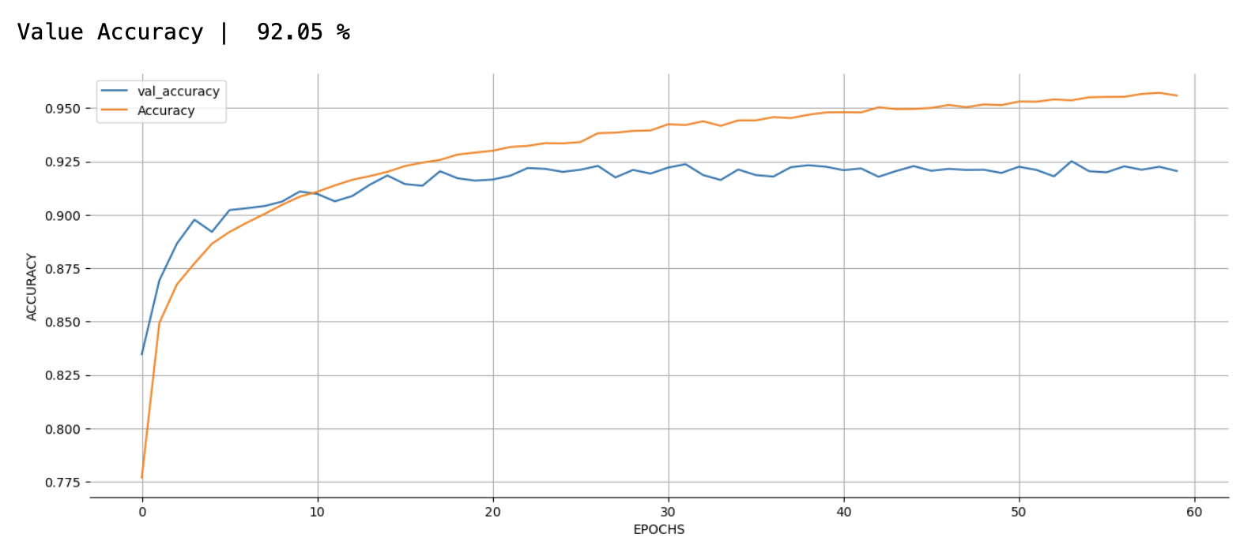
Fahion MNIST
Result
It used test data as validation data and got training loss and validation loss. The epoch is 60 and batch size is 128.
Accuracy
51

Slide 55
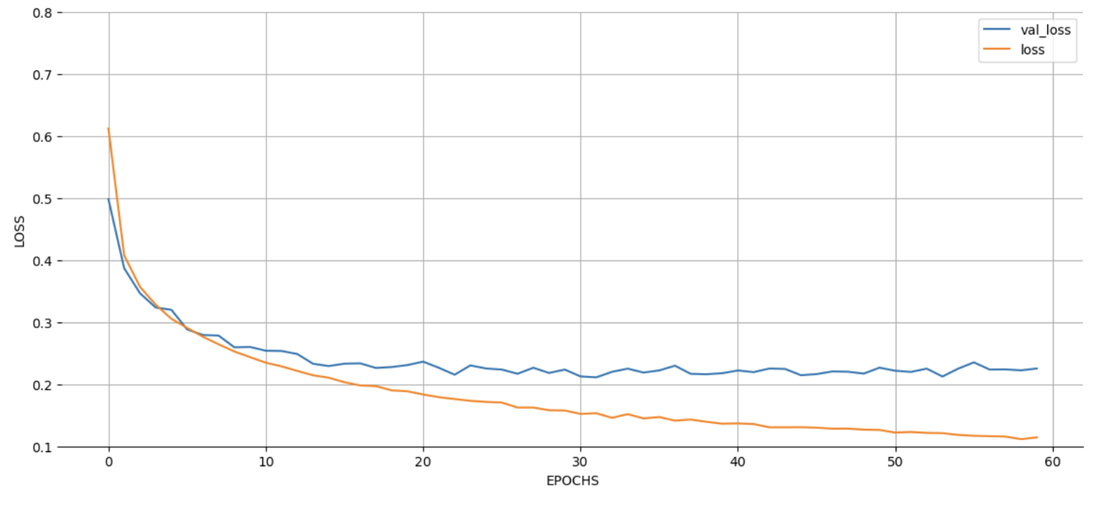
Fahion MNIST
Result
Loss
52

Slide 56
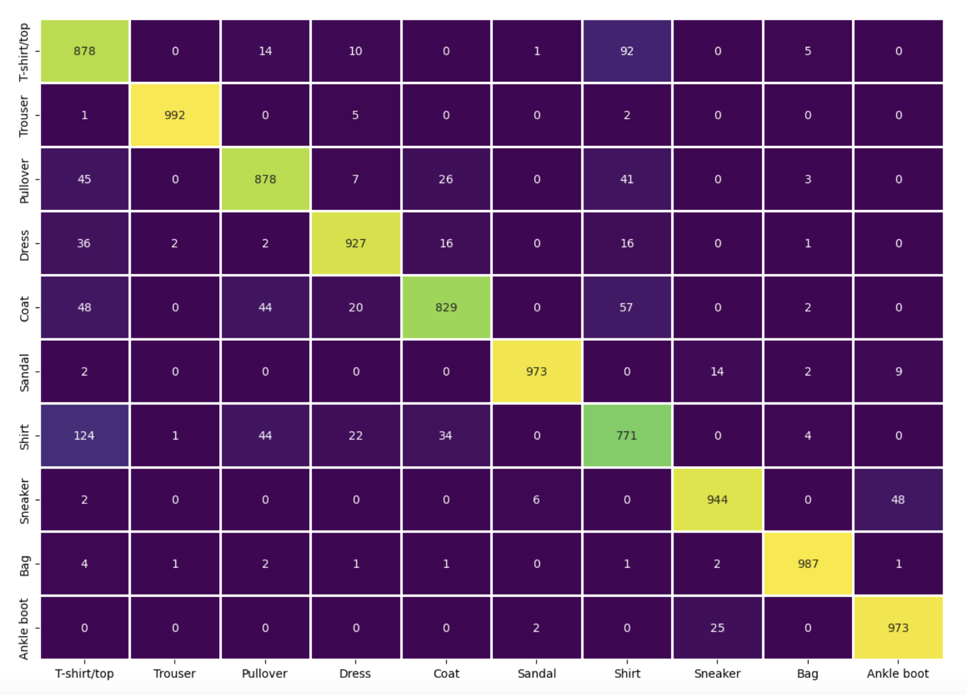
Fahion MNIST
Result
Confusion Matrix
53

Slide 57
Fahion MNIST
Result
We utilized the Sequential module to construct a LeNet, achieving an approximate accuracy of 95% during training and 92% for testing. The loss consistently decreased, indicating the network's robustness. An analysis of the confusion matrix revealed that the "Shirt" class posed a greater challenge for LeNet in terms of classification, while the "Trouser" class achieved the highest classification accuracy.
54

Slide 58
^{Appendix}
55

Slide 59
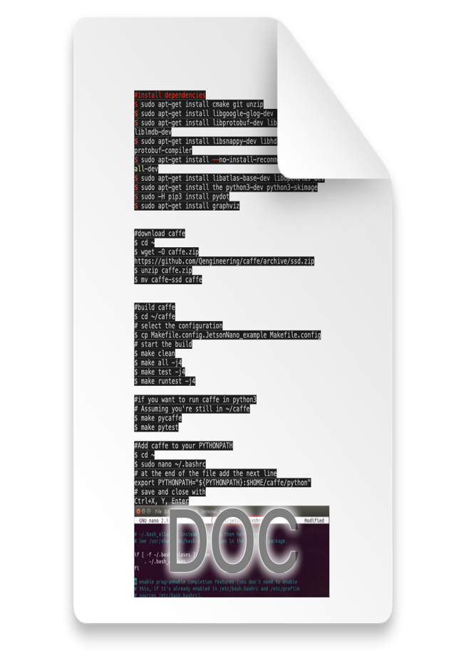
Install Caffe
Install caffe guidance
56

Slide 60
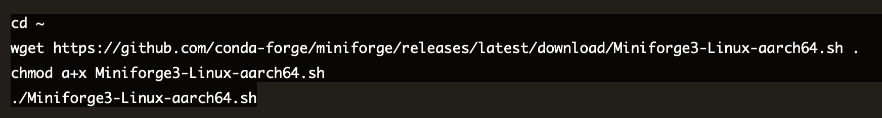
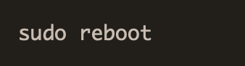
Jupyter setup
Setup Jupyter notebook on jetson nano
Install anaconda/miniforge:
Using a virtual environment can help prevent system instability when managing packages. Anaconda is a good toolset to manage environments and packages. While on Windows, Mac and Linux, we have the flexibility of using Anaconda, the ARM platform has limited choices. One such choice is miniforge(same use as Anaconda).
Run the code below to install miniforge3:
57

Slide 61
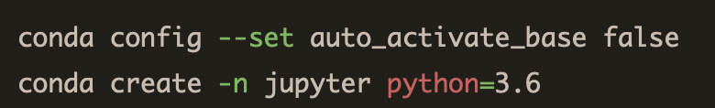
Jupyter setup
Setup Jupyter notebook on jetson nano
2. Install some foundational python packages:
3. Configure and create a new environment with anaconda:
58

Slide 62
Jupyter setup
Setup Jupyter notebook on jetson nano
4. Activate the new-create jupyter environment and install packages inside this environment:
$conda activate jupyter
$conda install jupyter matplotlib pandas numpy pillow scipy tqdm scikit-image scikit-learn seaborn cython h5py ipywidgets -c conda-forge
5. Configure jupyter notebook:
$jupyter notebook --generate-config
$jupyter notebook password
we can edit the configuration file by using vim command:
$vim /home/xt/.jupyter/jupyter_notebook_config.py
59

Slide 63
Jupyter setup
Setup Jupyter notebook on jetson nano
6. Run Jupyter Notebook in the new-create environment:
$conda activate jupyter
$jupyter notebook --no-browser
7. Move the browser side of the Jupyter equation to a desktop:
Since we only connect the jetson nano with PuTTY and it can not access to the PC browser, we need to setup SSH tunneling to connect jupyter servel with our PC browser. First we need to know the ip address of the jetson device by using $ifconfig. Then type the command below into your PC terminal:
ssh
$ssh -L 8000:localhost:8888 xt@[your device ip]
60

Slide 64
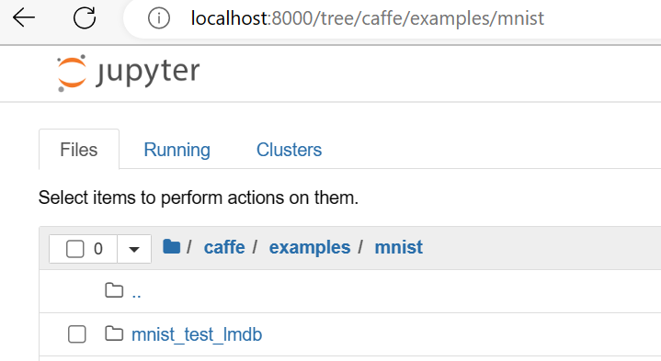
Jupyter setup
Setup Jupyter notebook on jetson nano
8. Finally connect the jupyter server in your browser:
by inputting “localhost:8000” in your browser address bar and hit enter.
61

Slide 65
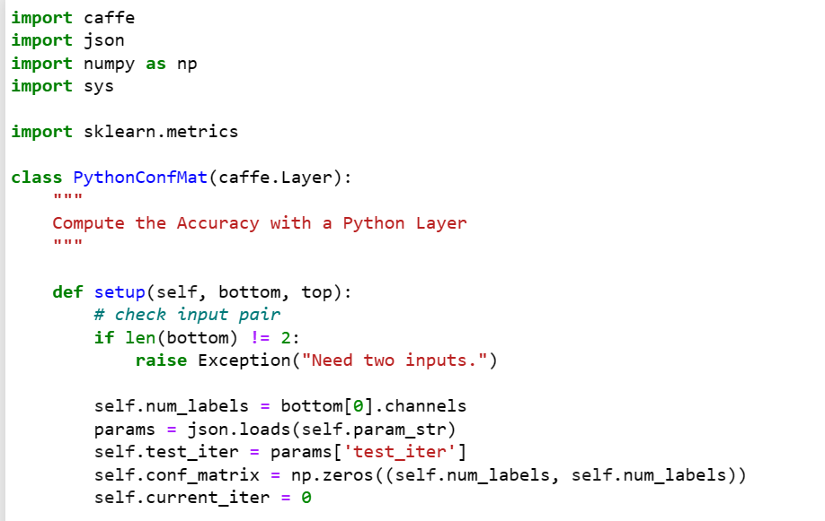
python_confmat.py
62

Slide 66
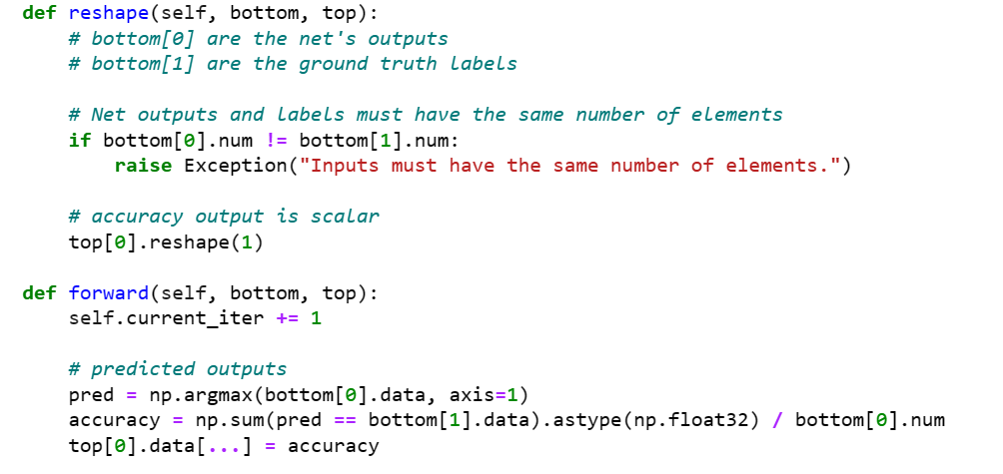
python_confmat.py
63

Slide 67
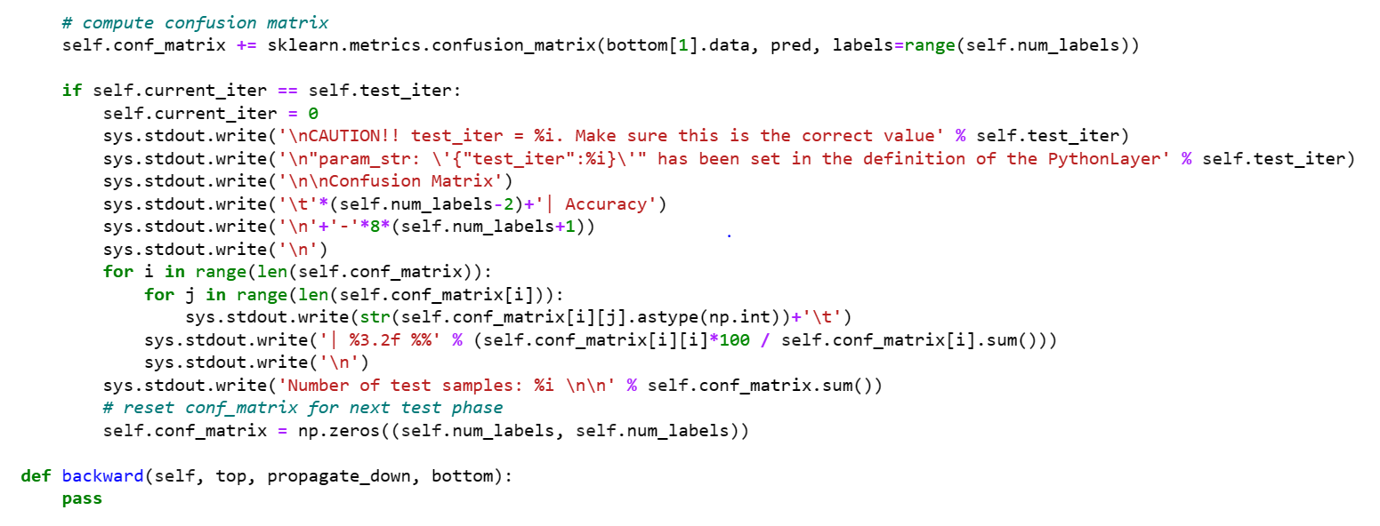
python_confmat.py
64

Slide 68
References
References and sources
[1]️https://developer.nvidia.com/embedded/learn/get-started-jetson-nano-devkit#setup
[2]https://caffe.berkeleyvision.org
[3]https://qengineering.eu/install-caffe-on-jetson-nano.html
[4]Y. Lecun, L. Bottou, Y. Bengio and P. Haffner, "Gradient-based learning applied to document recognition," in Proceedings of the IEEE, vol. 86, no. 11, pp. 2278-2324, Nov. 1998, doi: 10.1109/5.726791.
[5️]https://towardsdatascience.com/image-classification-in-10-minutes-with-mnist-dataset-54c35b77a38d
[6]️https://en.wikipedia.org/wiki/MNIST_database
[7]https://caffe.berkeleyvision.org/gathered/examples/mnist.html
65

Slide 69
References
References and sources
[8]https://www.kaggle.com/datasets/zalando-research/fashionmnist
[9]️https://github.com/Maitry-star/LeNet-With-Mnist-Fashion-Data/blob/main/Fashion_mnist_LeNeT-Model.ipynb
66

Slide 70
Thank You

